Slide 1


Efficient H.264 Encoder with High Profile for High Frame Rate Video Streams.
FYDP Group No.: 19
Project Supervisor: Dr. Muhammad Tahir
Department of Electrical Engineering,
University of Engineering and Technology Lahore
December 21, 2022

Slide 2
Group Introduction
Filza Shahid (Group Leader)
2019-EE-151
Specialization: Computer
Fariaa Faheem
2019-EE-001
Specialization: Computer
Marwa Waseem
2019-EE-007
Specialization: Computer
Hamza Akhtar
2019-EE-012
Specialization: Computer

Slide 3
Problem Statement
Develop an efficient H.264 encoder capable of handling high frame rate video streams by utilizing the High Profile of the H.264 family.
Be able to achieve high compression ratios while maintaining high video quality and preserving important details in the image.

Slide 4
Proposed Solution
Designing an independent Inter-Prediction module that works for one frame.
Incorporating Inter-Prediction into the main module to exploit temporal redundancies to achieve higher compression ratios.

Slide 5
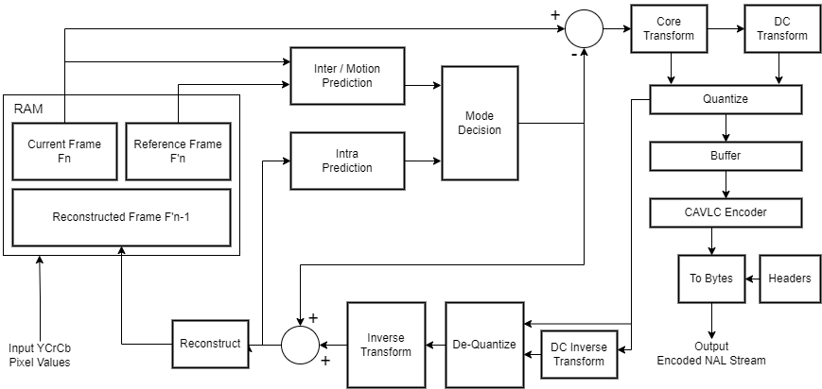
Block Diagram

Slide 6
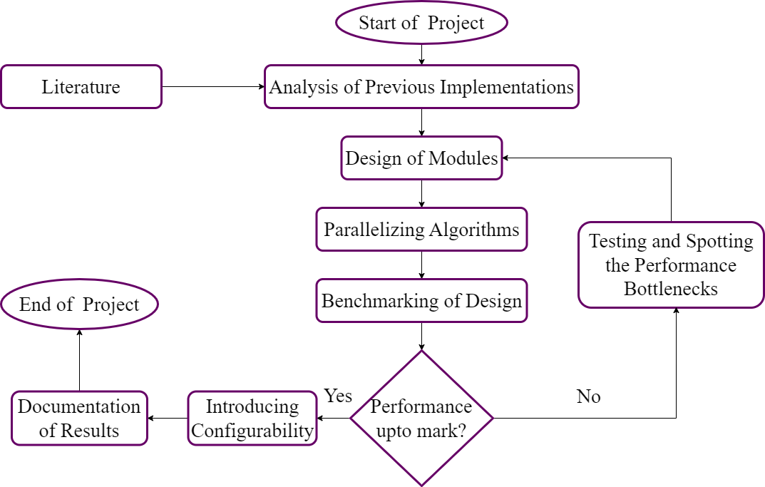
Flow Diagram

Slide 7
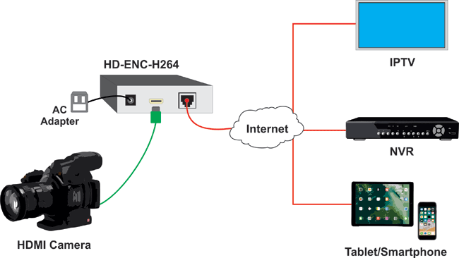
Applications
Internet video surfing and streaming

Slide 8
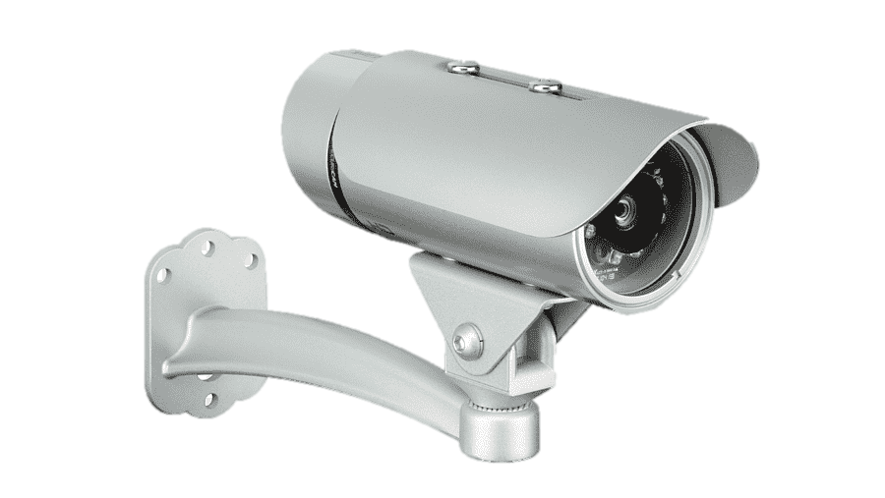
Applications
Video Surveillance cameras

Slide 9
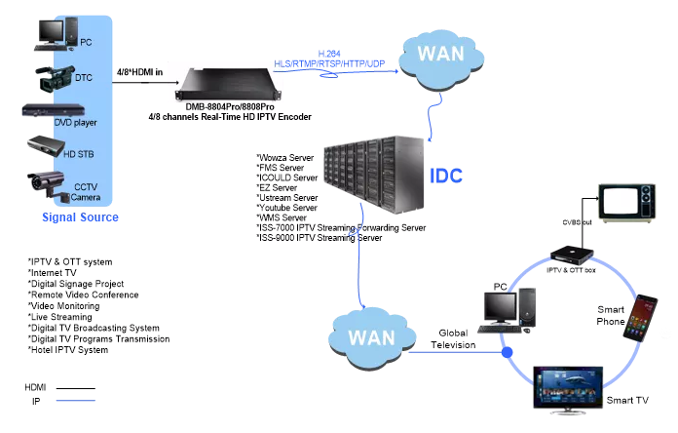
Applications
High-Definition TV broadcasting

Slide 10
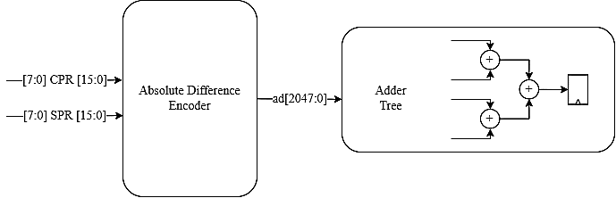
Flowchart for Inter-Prediction

Slide 11
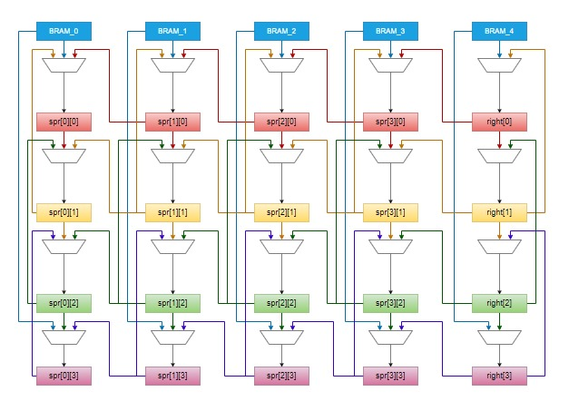
Variable Block Size Estimation

Slide 12
Current Progress
Take the open-source code for Base Profile with Intra Prediction from Zexia Access Ltd © 2008 in VHDL as Reference.
Tested independent H.264 modules in VHDL (source code from Zexia).
Simulated all VHDL modules together using QuestaSim.

Slide 13
Current Progress
Output H.264 video is obtained in correct format.
Raw video with .yuv format is used as input and H.264 compressed video is the output.
Converted modules to Verilog using YoSys Toolchain with GHDL plugin.

Slide 14
Current Progress
Both VHDL and Verilog modules were tested using Conformal Logic Equivalence tool.
Shifted to manual conversion of VHDL code to System Verilog.

Slide 15
Current Progress
Converted and Verified the modules independently
Simulated the converted modules all together using QuestaSim.
Verified the Output H.264 format video obtained from both codes.

Slide 16
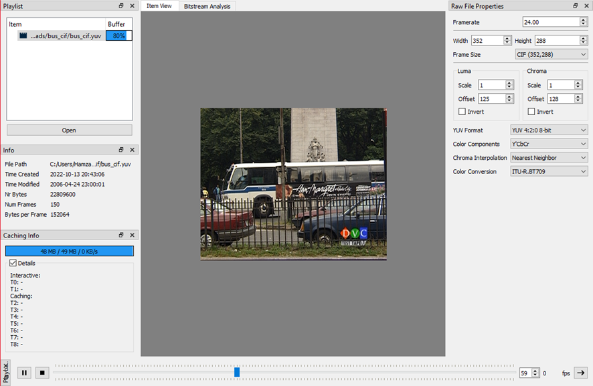
Current Progress
CIF - 352x288
8-Bit
4:2:0

Slide 17

Current Progress
QP = 28
Raw Video Size: 22 MB
Encoded Video Size: 2.47 MB
SNR: Y ~ 34.5 dB, U ~ 41.4 dB, V ~ 43.5 dB

Slide 18

Current Progress
QP = 15
Raw Video Size: 22 MB
Encoded Video Size: 5.39 MB
SNR: Y ~ 45.9 dB, U ~ 47.7 dB, V ~ 48.6 dB

Slide 19
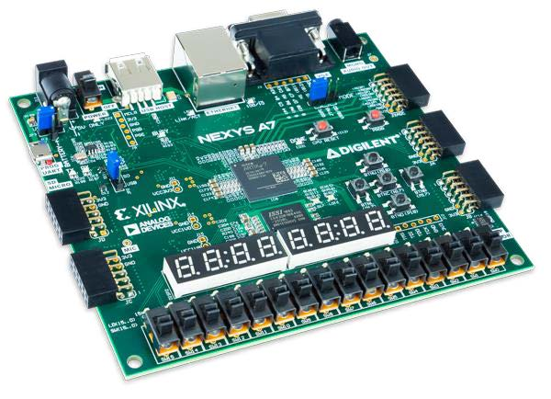
Hardware
Xilinx Artix-A7 FPGA will be used to verify the workings of the encoder in real-time.

Slide 20
Future Deliverables
Substantiate a compressed H.264 format video as output from the given raw input for different frame resolutions.
Verify the output using Field Programmable Gate Array (FPGA): Xilinx Artix-A7.

Slide 21
Future Deliverables
High profile enabled H.264 encoder.
Introduce Pipelining in the process of encoding to maximize the throughput.
Writing a Research Paper documenting our implementation.

Slide 22
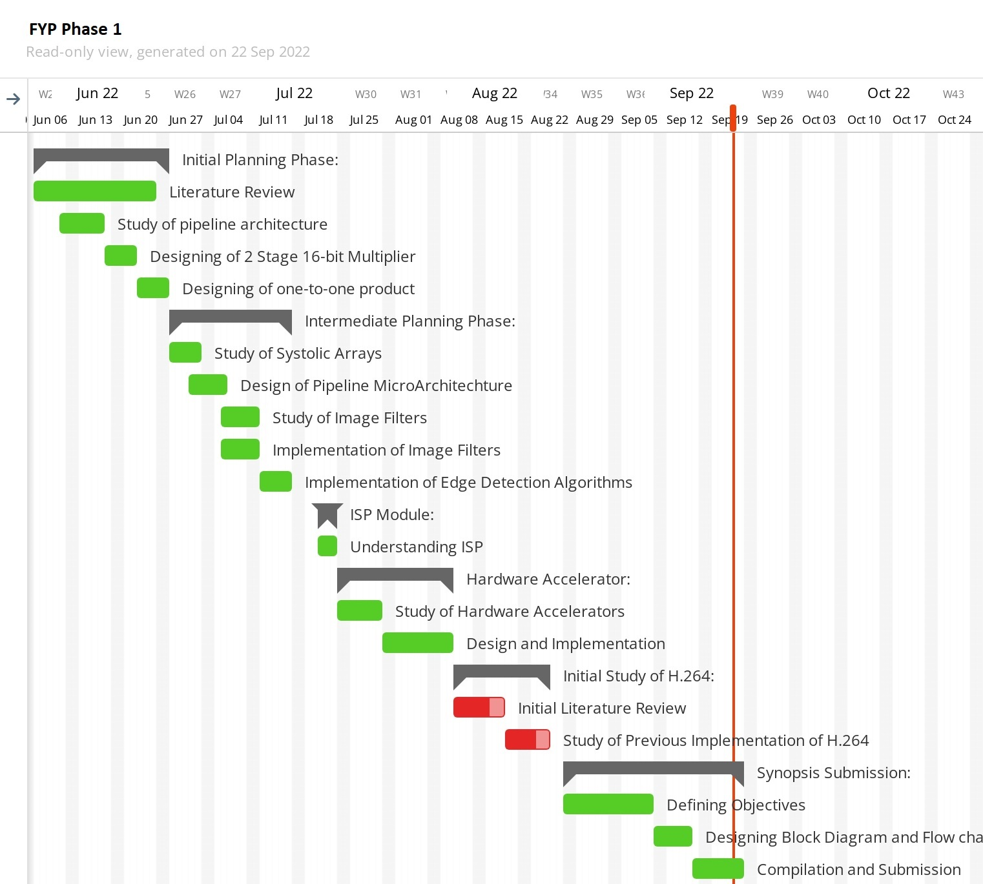
Gantt Chart

Slide 23
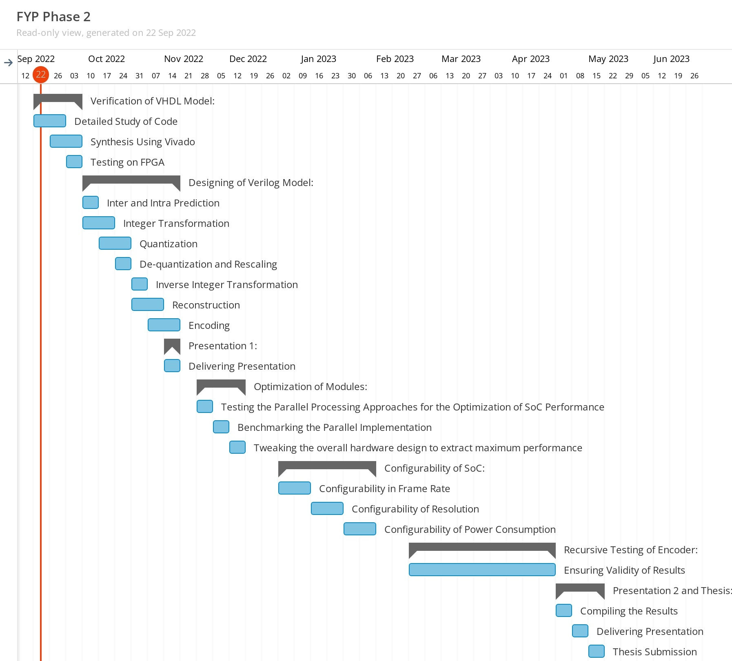
Gantt Chart

Slide 24
References
Yu-Han Chen, Tung-Chien Chen, Chuan-Yung Tsai, Sung-Fang Tsai, and Liang-Gee Chen. Algorithm and architecture design of power-oriented h.264/avc baseline profile encoder for portable devices. IEEE Transactions on Circuits and Systems for Video Technology, 19(8):1118–1128, 2009. doi: 10.1109/TCSVT.2009.2020323.)

Slide 25
References
Zhenyu Liu, Yang Song, Ming Shao, Shen Li, Lingfeng Li, Shunichi Ishiwata, Masaki Nakagawa, Satoshi Goto, and Takeshi Ikenaga. Hdtv1080p h.264/avc encoder chip design and performance analysis. IEEE Journal of Solid-State Circuits, 44(2):594–608, 2009. doi: 10.1109/JSSC.2008.2010797.

Slide 26
References
Iain E. Richardson. THE H.264 ADVANCED VIDEO COMPRESSION STANDARD. John Wiley Sons Ltd, 2003.
T. Wiegand, G.J. Sullivan, G. Bjontegaard, and A. Luthra. Overview of the h.264/avc video coding standard. IEEE Transactions on Circuits and Systems for Video Technology, 13(7):560–576, 2003. doi: 10.1109/TCSVT.2003.815165.

